Slide 1
ESET Case Study
Gasper Peter

Slide 2
Compared AV software
ESET Internet (Smart) Security 10 Beta
Kaspersky Internet Security 2017
Both products are all-in-one security products with integrated firewall and anti-malware, anti-spam capability. Additional features shared between both products includes webcam protection and online banking protection.

Slide 3
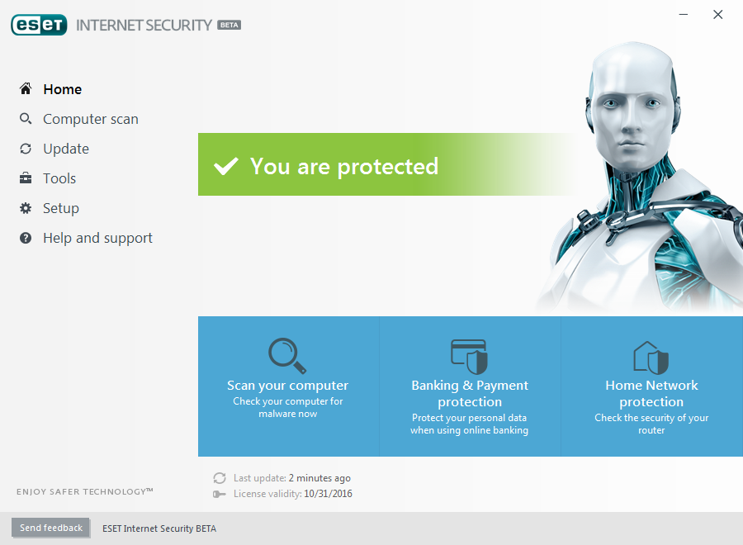
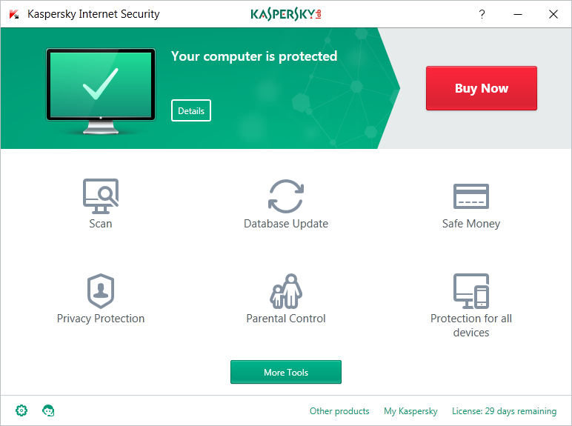

Slide 4
HOME user hypothesis
Home users are:
Demanding new features every product iteration
Do not like distraction (pop-ups)
Do not want resource consumption (cpu, memory)
Can't compare detection mechanisms in depth

Slide 5
Features relevant to Home user
Major features:
Core, but ubiquitous functionality (AV, Firewall)
Parental Control
Banking and Payment Protection
Webcam Protection
identity protection (VPN)
Ad Blocking
Gamer mode

Slide 6

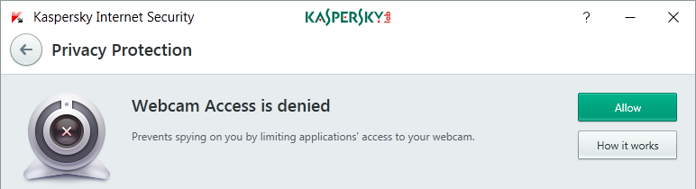
Webcam protection
Both products

Slide 7
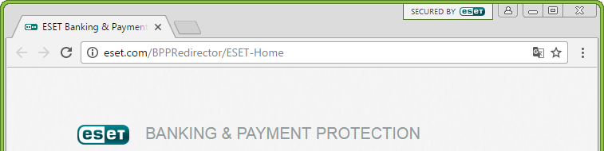
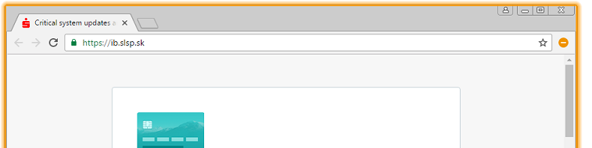
Banking and Payment protection
Both products use browser without extensions
KIS 2017:
allows only whitelisted URLs
Injects javascript keyboard

Slide 8
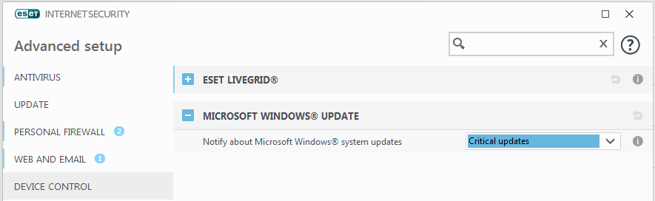
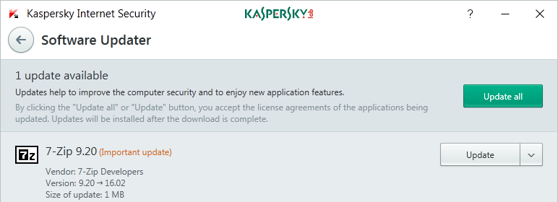
Watchdog for outdated 3rd party apps
EIS 10 only Windows updates
KIS 2017 also other 3rd party apps

Slide 9
ESET features
Mostly detection related:
Botnet Protection
Network attack protection
Home network protection & router recognition
SysInspector
Most features are very customizable

Slide 10
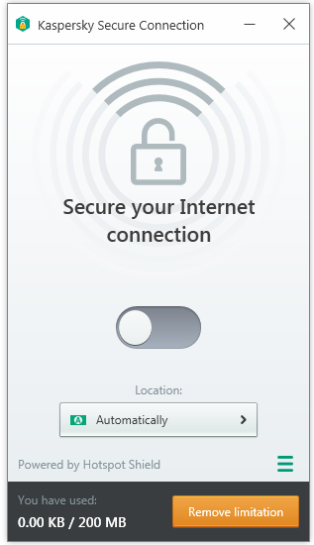
Kaspersky features
Additional features:
3rd party software vulnerability scan & patch
Software & private data cleaning
VPN functionality
Browser extension:
  Ad Blocking
  link reputation engine
But bigger ATTACK surface !!!

Slide 11
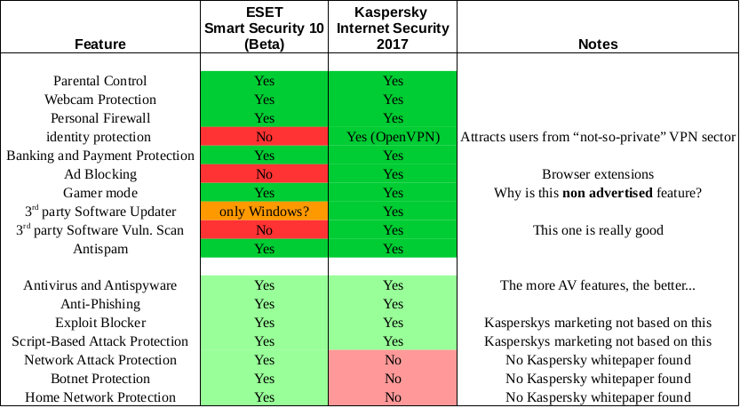
Comparison

Slide 12
Thank you for your time
Questions?

